Slide 1
Wasserstein-Based Control Architecture:
From agent dynamics to optimal transport regulation
Georgios Krommydas
gkrommydas@mail.ntua.gr

Slide 2
Overview
Measure-Theoretic Setting.
Real Applications.
Optimal Transport Interpretation.
Distributional Control Problem.

Slide 3

Measure-Theoretic Setting
$(𝒳, d)$: Polish metric space
  $𝒫_{p}(X)$: set of probability measures with finite p-th moment
  $\int_{𝒳}{d{\left(x, x_{0}\right)}^{p} dμ(x)} < ∞$ for some $x₀ ∈𝒳$

Slide 4

Definition of Wasserstein Distance
Let $μ, ν ∈ 𝒫_{p}(X)$
  $Π\left(μ, ν\right)$: set of couplings with marginals $μ$ and $ν$
  $$W_{p}(μ, ν) ={\left(\inf_{γ∈Π\left(μ,ν\right)}\left\{\int_{𝒳×𝒳}{d{\left(x,y\right)}^{p} dγ(x,y)) }\right\} \right)}^{\frac{1}{p}}$$

Slide 5

Key Properties
Defines a metric on $𝒫_{p}(X)$
  Measures weak convergence + moment convergence
  Sensitive to geometry of the underlying space

Slide 6
Why Wasserstein Distance in Control?
Control of distributions instead of trajectories
  Mean-field and swarm systems
  Robustness to noise and model uncertainty
  The controller operates in the space of probability measures, while the physical robots only implement agent-level dynamics.

Slide 7
Real Applications
Swarm robotics formation shaping
  Consensus under uncertainty
  Stochastic MPC with distributional costs

Slide 8
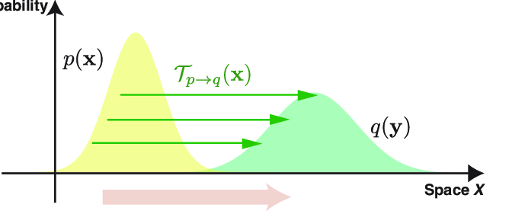
Optimal Transport Interpretation
Source measure μ
Target measure ν

Slide 9
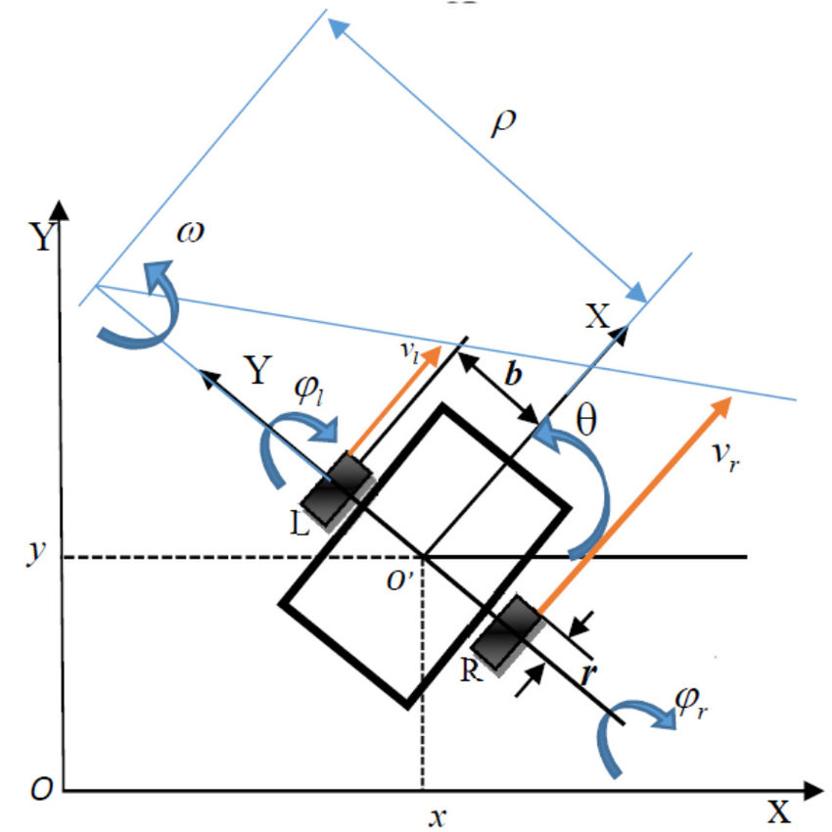
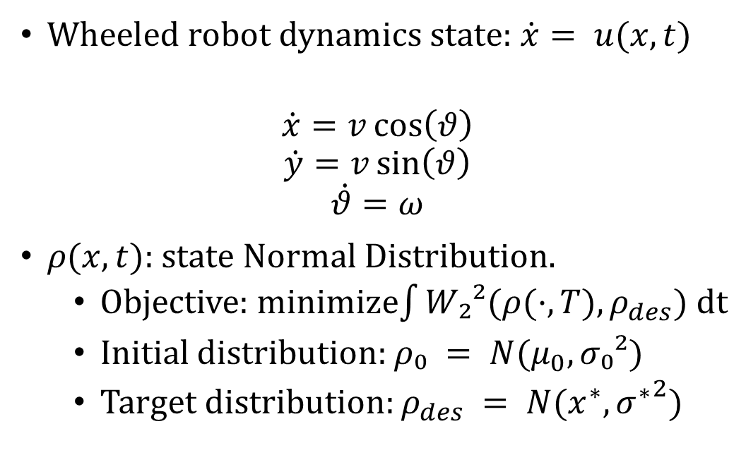
Distributional Control Problem
Wheeled robot dynamics state: $\dot{x}= u(x,t)$
$$\dot{x}=v\cos\left(θ\right)$$
$$\dot{y}=v\sin\left(θ\right)$$
$$\dot{θ}=ω$$
$ρ(x,t)$: state Normal Distribution.
  Objective: minimize$\int{W₂²(ρ(·,T), ρ_{des}) \text{dt}}$
  Initial distribution: $ρ₀ = N(μ_{0}, σ₀²)$
  Target distribution: $ρ_{des} = N(x^{∗}, {σ^{∗}}^{2})$

Slide 10

Probability Measure Modeling
Agent positions $p_{i}(t) ∈ ℝ²$
Empirical measure: $ρ^{N}\left(t\right)= \left(\frac{1}{N}\right)\sum_{n=1}^{N}{δ_{p_{i\left(t\right)}}}$
Mean-field representation: $ρ\left(t\right) ∈𝒫_{2}\left(ℝ^{2}\right)$

Slide 11
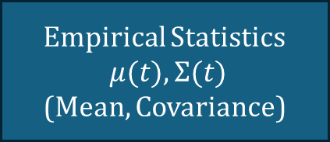
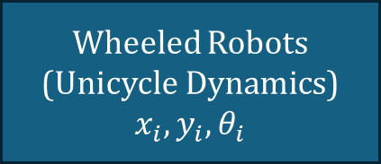
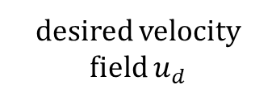
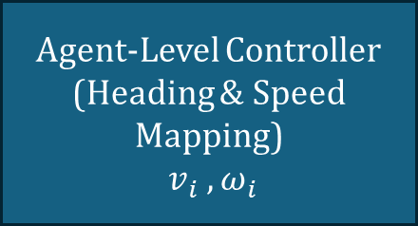
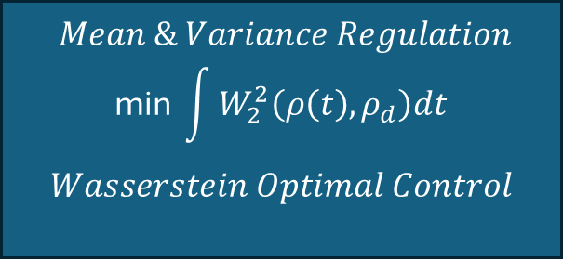
Mean-Field Control via Wasserstein Distance
$$Mean \& Variance Regulation$$
$$\text{min} \int{W_{2}^{2}\left(ρ\left(t\right), ρ_{d}\right)dt}$$
$$Wasserstein Optimal Control$$
Wheeled Robots
(Unicycle Dynamics)
$$x_{i}, y_{i}, θ_{i}$$
states
Empirical Statistics
$μ(t), Σ(t)$
(Mean, Covariance)
distribution
desired velocity field $u_{d}$
Agent-Level Controller
(Heading & Speed Mapping)
$v_{i} , ω_{i}$
control inputs

Slide 12

Empirical Statistics
$μ\left(t\right)=\frac{1}{N}\sum_{i=1}^{N}{p_{i}(t) }$
$Σ\left(t\right)=\frac{1}{Ν} \sum_{i=1}^{N}{\left(p_{i}\left(t\right)− μ\left(t\right)\right)\left(p_{i}\left(t\right) − μ\left(t\right)\right)ᵀ }$

Slide 13


Wasserstein High Level Control Law
Optimal Control Problem
$$\min_{ρ\left(t\right)}{\int_{0}^{T}{W_{2}^{2}\left(ρ\left(t\right), ρ_{d}\right)dt}}$$
$u_{d} = −k_{m}\left(μ\left(t\right)−μ_{d}\right) − k_{s}\left(σ\left(t\right)−σ_{d}\right)$
Mean & variance regulation
Mapped to $(v_{i}, ω_{i})$

Slide 14

Analytical Insight (Gaussian Case)
Closed-form Wasserstein distance:
  $W₂² = {\left\|μ_{1}−μ_{2}\right\|}^{2} +tr\left(Σ_{1}+Σ_{2} −2{\left(Σ_{2}^{1/2}Σ_{1}Σ_{2}^{1/2}\right)}^{1/2}\right)$
  Diagonal $Σ→W₂² ={\left\|μ −μ_{d}\right\|}^{2}+ {\left\|σ −σ_{d}\right\|}^{2}$
  Control drives mean and variance to desired values

Slide 15

Wasserstein Low Level Control Law
Reference heading
              $θ_{ref} \text{​=} \text{atan}\text{2}\text{( }u_{d_{y}}\text{(}\text{t}\text{) ,}u_{d_{x}} \text{(}\text{t}\text{)) }$
Linear velocity (per agent)
              $v_{i}\left(t\right)=k_{v}\left\|u_{d}\left(t\right)\right\|\cos\left(θ_{i} −θ_{ref}\right)$
Angular velocity (per agent)
              $ω_{i}\left(t\right)=−k_{ω}\sin\left(θ_{i} −θ_{ref}\right)$

Slide 16
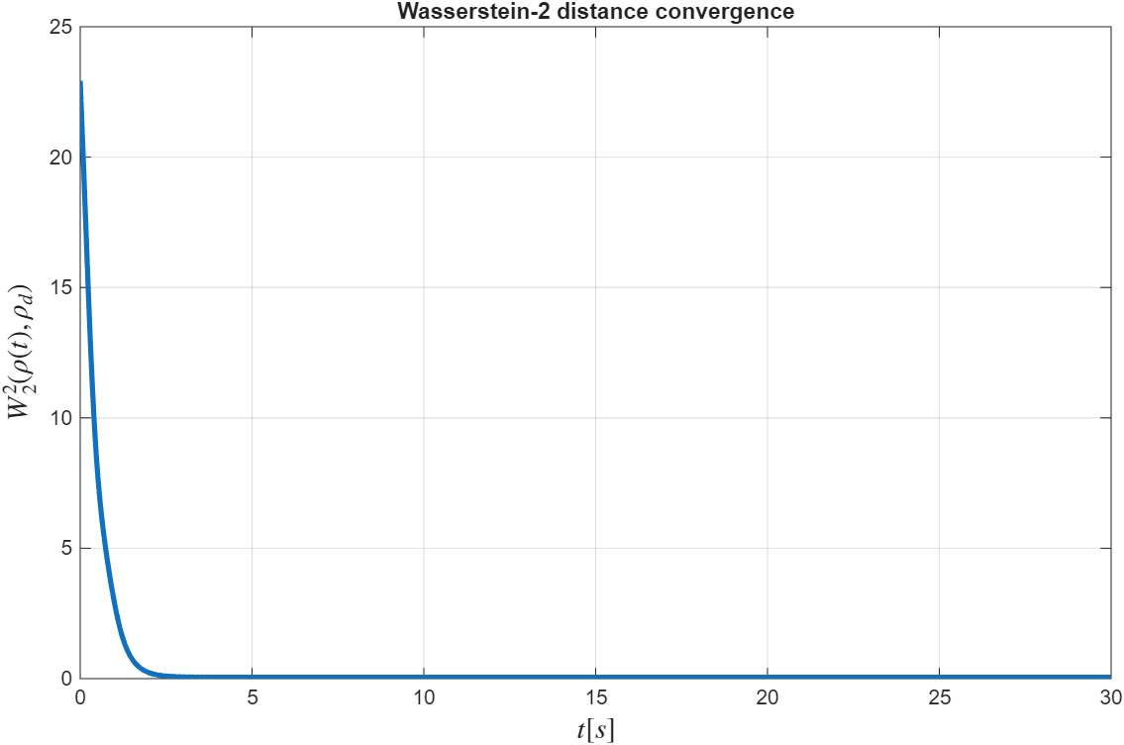

Performance Metric
$W₂²(t) = {\left|\left|μ\left(t\right)−μ_{d}\right|\right|}^{2} + {\left|\left|σ\left(t\right)−σ_{d}\right|\right|}^{2}$
Convergence ⇒ optimal distribution tracking

Slide 17
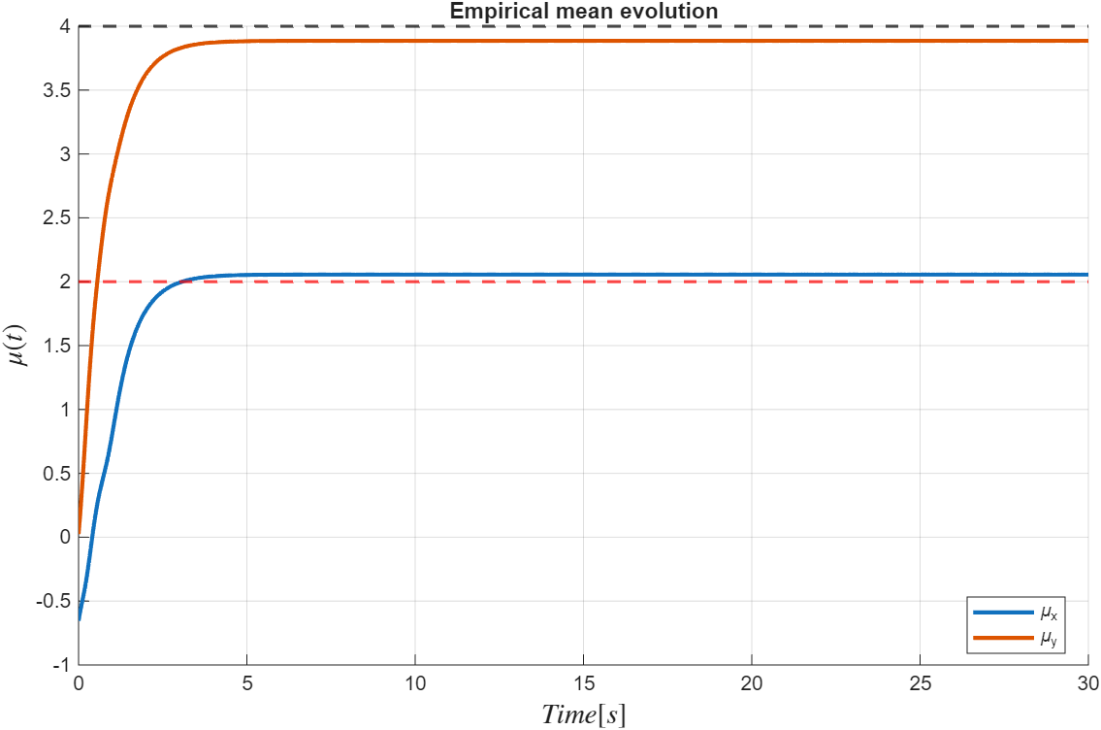
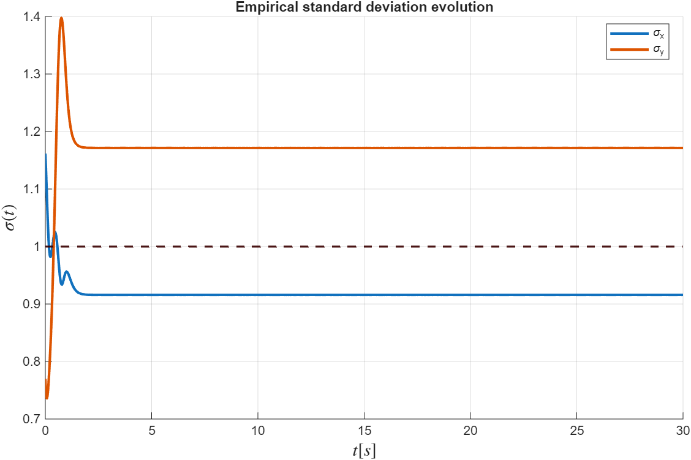
Empirical Statistics Plots

Slide 18
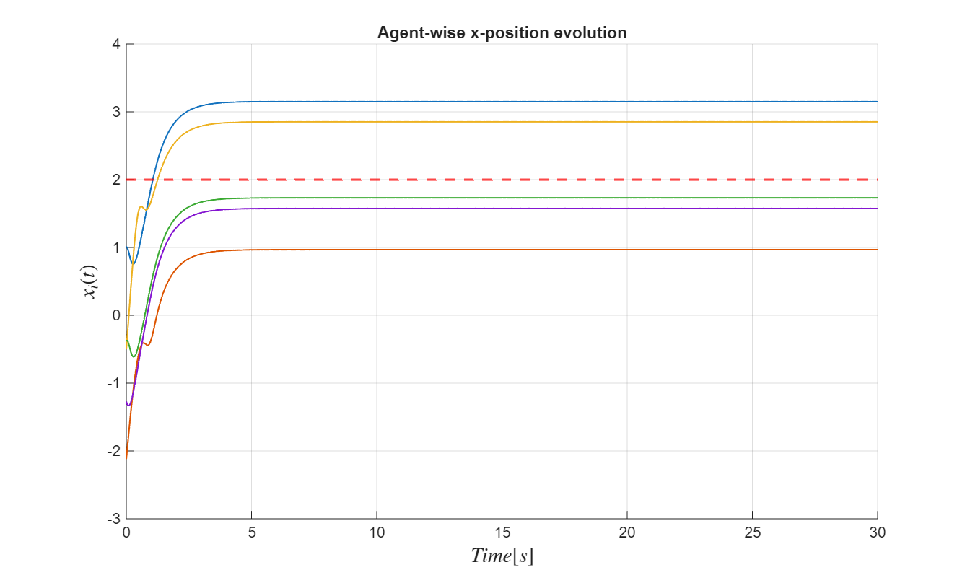
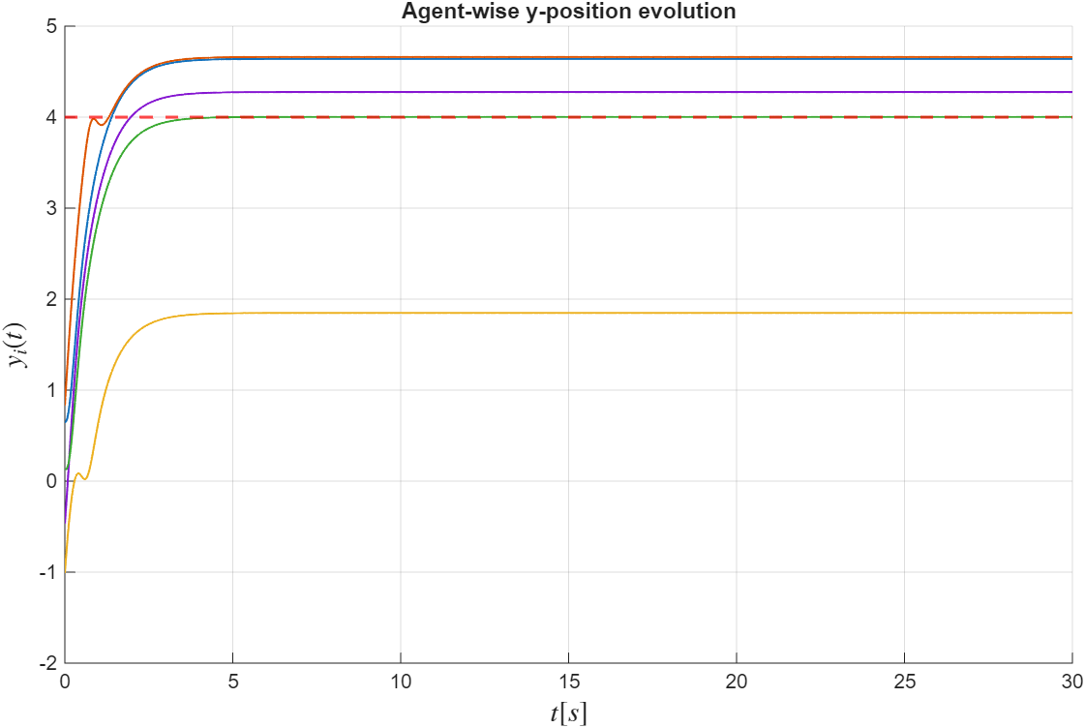
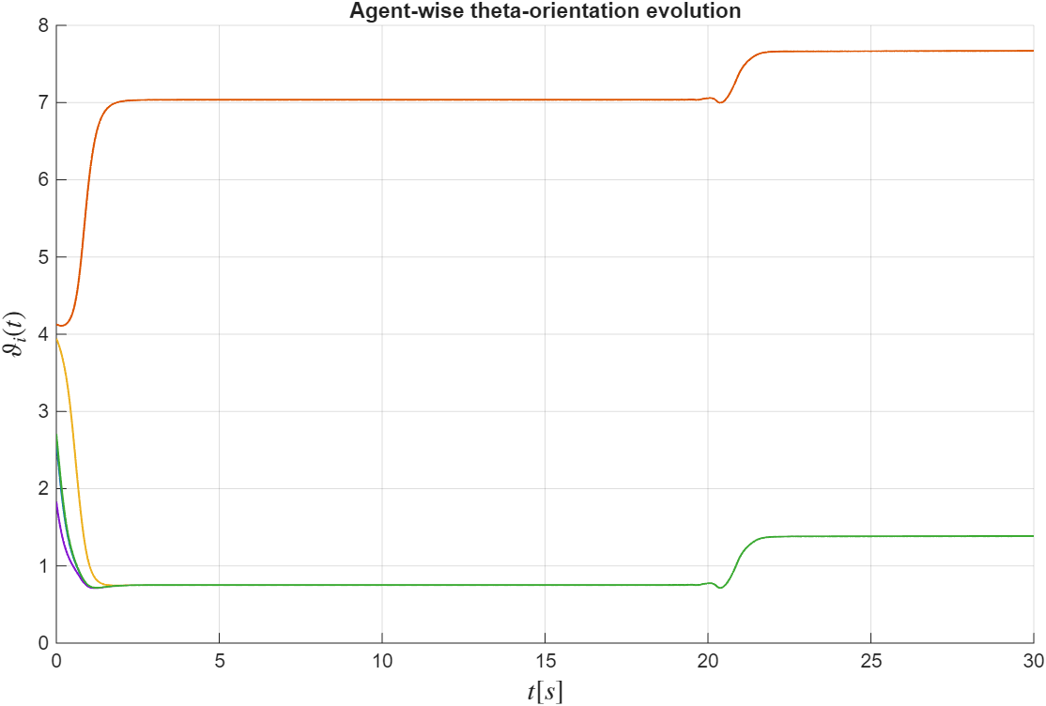
State of Every Agent

Slide 19
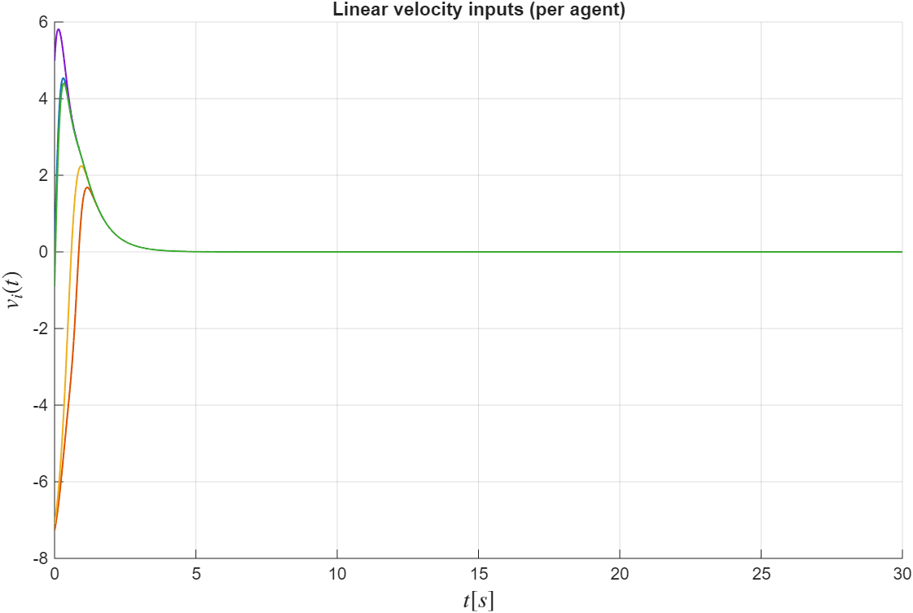
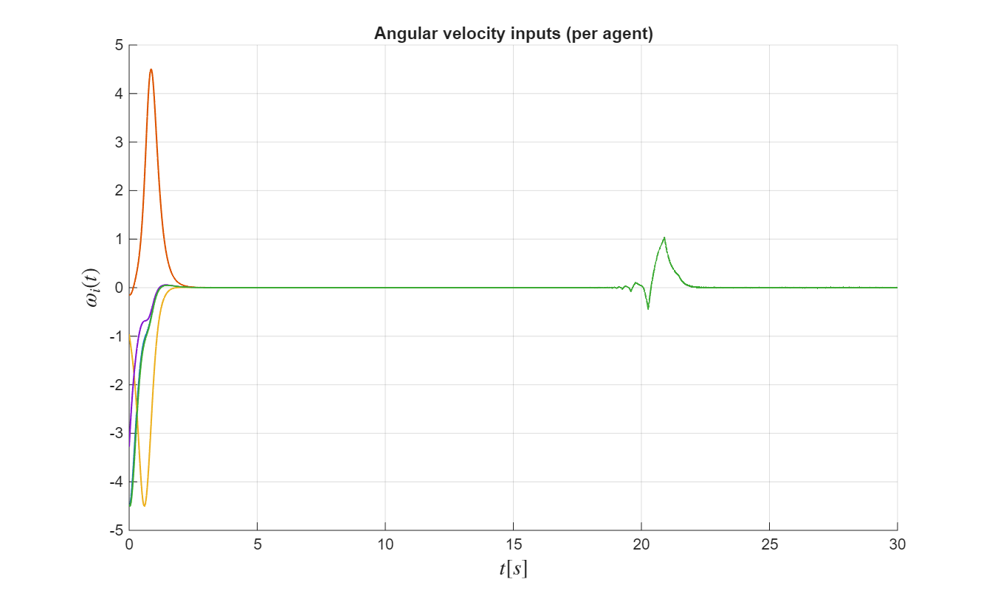
Control Input of Every Agent

Slide 20
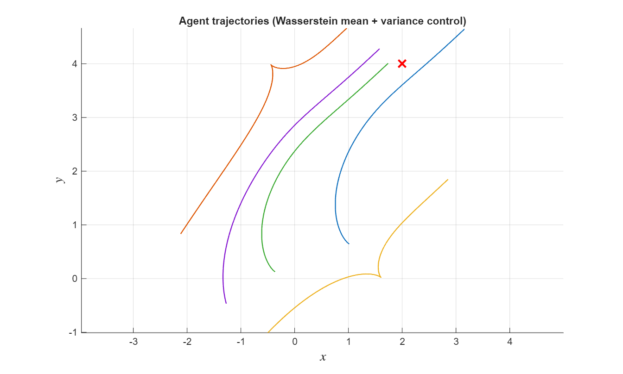

Slide 21
References
C. Villani, Optimal Transport: Old and New, Springer, 2009
Peyré & Cuturi, Computational Optimal Transport, 2019
Chen, Georgiou, Pavon, Optimal Transport in Control, Annual Review

Slide 22
Thank you!
Questions?

